Slide 1
Analysis of Pay Disparity Between Men and Women at a Bank
A Comprehensive Study
Kamaal Bartlett

Slide 2
Introduction
Objective: Investigate pay disparity between men and women at a bank
Research Questions:
Is there a significant difference in starting salary between men and women?
How does including gender as a variable affect salary predictability?

Slide 3
Data Source and Definitions
Data Source: Sleuth3 library (case 1202)
Variables:
Bsal: Starting salary
Sal77: Salary in 1977
Sex: Gender (Male/Female)
Senior: Seniority
Age: Age
Educ: Education Level
Exper: Years of Experience

Slide 4
Main Features of the Data Set
Summary Statistics:
Overall mean salary: $5420
Minimum salary: $3900
Maximum Salary: $8100
Gender-specific Statistics:
Males: Mean Salary $5956.88
Females: Mean Salary $5138.85
Difference: $818.03

Slide 5
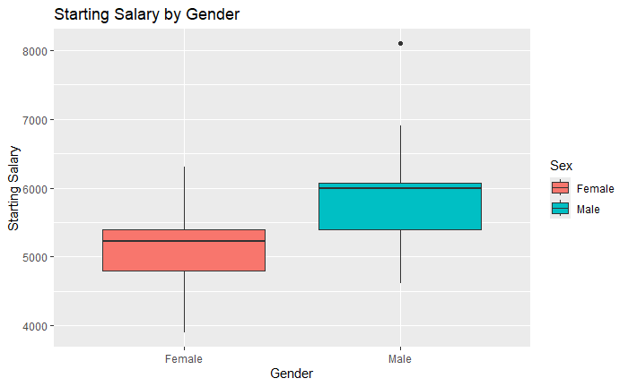
Data Visualization
Figure 1: Boxplot of Starting Salaries by Sex
Men have higher average starting salaries compared to women
Lowest and highest starting salaries for men are higher than for women

Slide 6
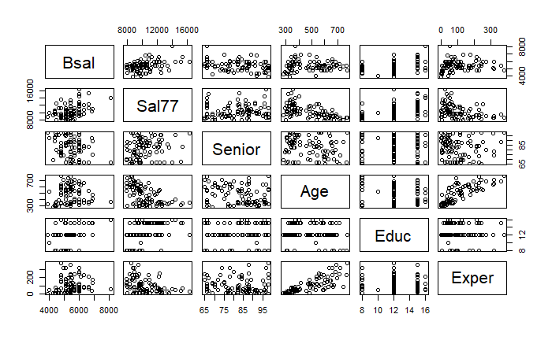
Data Visualization (Continued)
Figure 2: Scatter Plot Matrix
Relationships between starting salary and other variables

Slide 7
Research Question
Is there a significant difference in starting salary between men and women at the bank?
How does including gender as a variable affect salary predictability?

Slide 8
Methodology
Two-Sample T-Test:
Compare starting salaries of men and women
Results: Significant difference with a p-value of 3.71e-07
Power Analysis:
Ensured sufficient sample size
Effect size (Cohen’s d): 1.37351
Power: 0.99999

Slide 9
Regression Analysis
Without Gender Variable:
Identified predictors: ‘Sal77’, ‘Senior’, ‘Age’, ‘Educ’
With Gender Variable:
Gender significantly improves the model’s predictive ability
Increased R-squared value

Slide 10
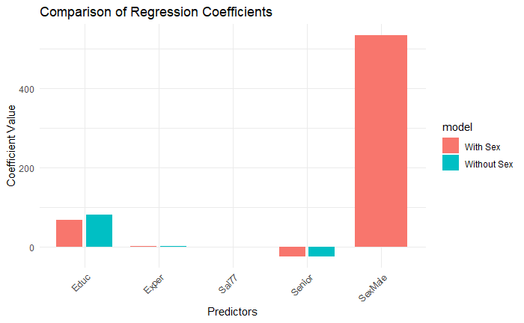
Visualization of Results
Figure 3: Comparison of Regression Coefficients
Significant coefficient for ‘SexMale’

Slide 11
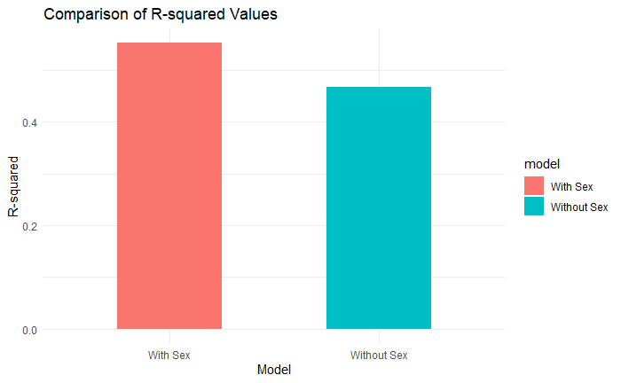
Visualization of Results (Continued)
Figure 4: R-squared values Comparison
Improved model fit with gender variable

Slide 12
Discussion of Methods
Model Building Methods:
Forward Selection: Adds predictors one by one based on statistical significance
Backward Elimination: Removes predictors one by one based on lack of statistical significance
Transformations:
Log transformation was applied to the response variable to stabilize variance and make relationships linear

Slide 13
Explanation of Interaction Terms
Two-way interaction terms:
Examines if the relationship between two predictors depends on a third variable
Evaluated but not all were significant

Slide 14
Conclusion
Statistical Conclusion:
There is a significant gender pay gap favoring men
Practical Implications:
A policy change is needed to address the pay equity at this bank
Conclusion for a Judge:
Based on statistical evidence, there is a significant gender pay gap at this bank favoring men. This finding is consistent with potential gender discrimination, which the bank should address through policy changes and corrective actions

Slide 15
Possibility of Designed Experiment
Impracticality
Conduction a designed experiment where salaries are randomly assigned is impractical in a real-world setting. Employees’ salaries are influenced by various factors
Ethical concerns
Randomly assigning salaries could lead to ethical issues and employee dissatisfaction. It is not feasible to manipulate salaries purely for experimental purposes
Alternative Approaches
Instead of a designed experiment, observational data and statistical methods can be leveraged to identify and address disparities.

